Slide 1
CHINA US TRADE TALKS
Summary of the article and outline of impacts

Slide 2
Summary
China and US have engaged in trade talks aimed at reaching the agreement on industrial policy and technology issues affecting the two countries to foster trade
The trade is being conducted in Beijing however on Friday they adjourned according to Steven Mnuchin the U.S Treasury secretary
Mnuchin represented US while Lighthizer represented China
Donald Trump the U.S president was optimistic of the two countries reaching an agreement in the talks
Gao Feng the commerce ministry of China noted that there is serious commitments between the two countries.
Notes:
China and US have engaged in the trade talks for a long period of time without success. However this time round the negotiators are optimistic that positive results will come out of the discussions and change the previous perceptions.

Slide 3
Summary
The Washington’s rigidity on putting I place enforcement mechanisms that involves penalties for non-commitment behaviors remains a stumbling block
It is believed that the negotiations are unlikely to yield fruits on conflicts troubling the relations between the two countries. The most critical issues that seem not to be agreed upon are; the Chinas huge trade surplus with the U.S, also the accusations that China has transferred the foreign technology for selfish purposes.
The tariff issue to leverage the trade relations by president Trump
Notes:
According to the author, the stumbling block has been the US, the Washington's continuous insistence on enforcing penalties a situation that hasn’t gone well with the Chinese government as they suspect US is non-committal in the talks.

Slide 4
The countries impacted
The countries involved are the United States of America and China, which means the impacted will be on the two countries in context.
If the negotiations are positive it will mean the advantage for both countries on industrial policy matters and technology however, if it goes otherwise then they both stand to loose.
However there are other countries closely monitoring the situation and the outcome taking in consideration China and US are dominant forces in the international market.
Notes:
In the article it is the US and China the two main countries involved and this implies that the impact will be observed in the two countries although it can extent even to other countries.

Slide 5
Positive effect to the international trade
Development of other countries participating in the trade. As stated earlier, US and China are dominant nations on the international market, as such if they are in good terms it means they will actively participate in the international trade rather then engage in conflicts.
Increased supply of goods and services on the international trade market as both countries will be engaging constructively rather than negative divergence
Reduction of unfair tariffs. If the negotiations yield results it means the issue of tariffs that has dominated the negotiations will be done away with hence benefiting other countries participating in the international market.
Notes:
Both the two countries are active members in the international trade as such any good outcome will obvious translate to positive progress on the international trade. More goods will be supplied by both countries and also they will be keen to implement fair tariffs to benefit many people.

Slide 6
Positive effects in the international trade
It will encourage market competition. The positive negotiations between the US and China will boost the international market and hence bringing on board other different nations in the process increasing competition and this will help the production of quality products.
International growth. In the event both countries come in agreement it means that they will contribute positively at the international market and also help other countries to grow and this will automatically result in the growth of the international trade.
Notes:
Positive outcomes from the negotiations between China and US will create more competition at the international market hence there will be need for quality products to survive the competition and this will benefit the users. Besides, the international market will realize growth.

Slide 7
Negative impacts on the international trade
Monopoly of the market . In the event that the negotiations will be successful, it means that the US and China will keep on dominating the market hence affecting other countries participating in the trade hence benefiting only two countries.
Political risks. It is clear that the US president Donald Trump is always controversial in nature yet he has a lot of influence on the international trade US being a superpower. Already China has complained about Donald Trump interference in the negotiations and the latest tariffs he has proposed yet going forward it will complicate matters even worse.
Notes:
There is no doubt that the international market will be affected negatively as a result of the talks. For instance, if the two countries cooperate it is clear that they will dominate the international market hence create monopoly and take advantage to exploit the market.

Slide 8
Negative effects in the international trade
Effects of conflicts. Already US and China have been in a constant conflict on technology and industrial policy resorting to negotiations. However in the eventuality that the negotiations collapses it means that the conflict will continue and this will only impact negatively on the international market.
Exchange rates risks. There are various currencies that are used at the international market, however the US dollar tends to dominate the market. This means the international market heavily depends on the US dollar and as such if China and US will not end conflicts this is likely to affect the international market.
Notes:
If the negotiations will not bear fruits it will mean US and China will continue having conflict a situation that will affect the international trade in areas like the exchange rate market.

Slide 9
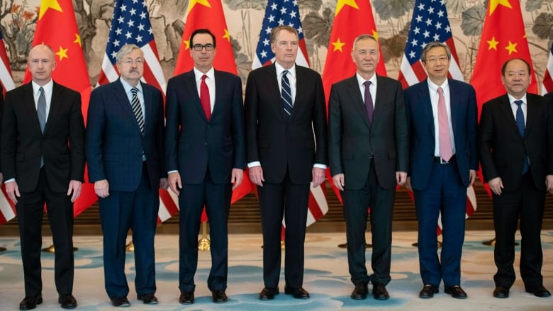
China, US Trade talk committee members
Notes:
From left, U.S. Deputy Trade Representative Jeffrey Gerrish, U.S. Ambassador to China Terry Branstad, U.S. Treasury Secretary Steven Mnuchin, U.S. Trade Representative Robert Lighthizer, China's Vice Premier Liu He, Yi Gang, governor of the People's Bank of China (PBC) and National Development and Reform Commission Vice Chairman Ning Jizhe pose for a group photo at Diaoyutai State Guesthouse in Beijing Friday, March 29, 2019

Slide 10
Link to the article
https://www.cbc.ca/news/business/us-china-trade-talks-1.5076702
Notes:
The above is the link to the US and China trade talks

